Slide 1

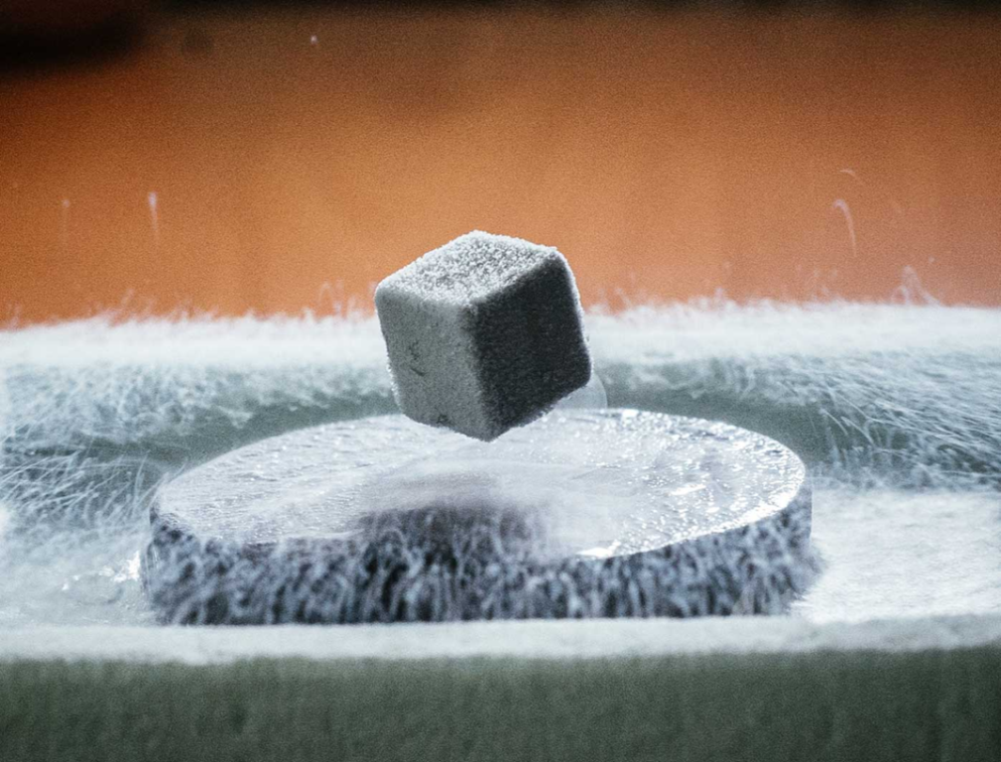

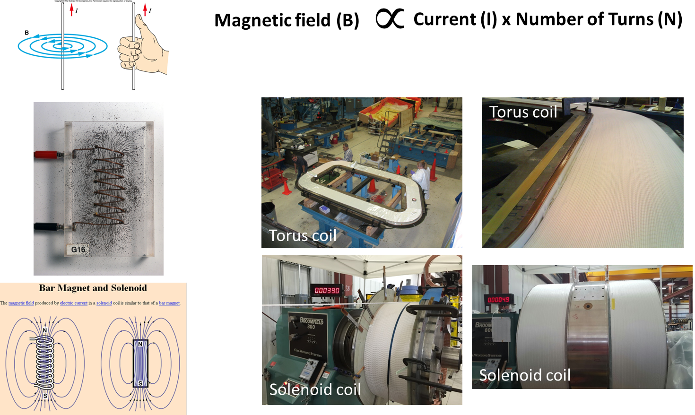

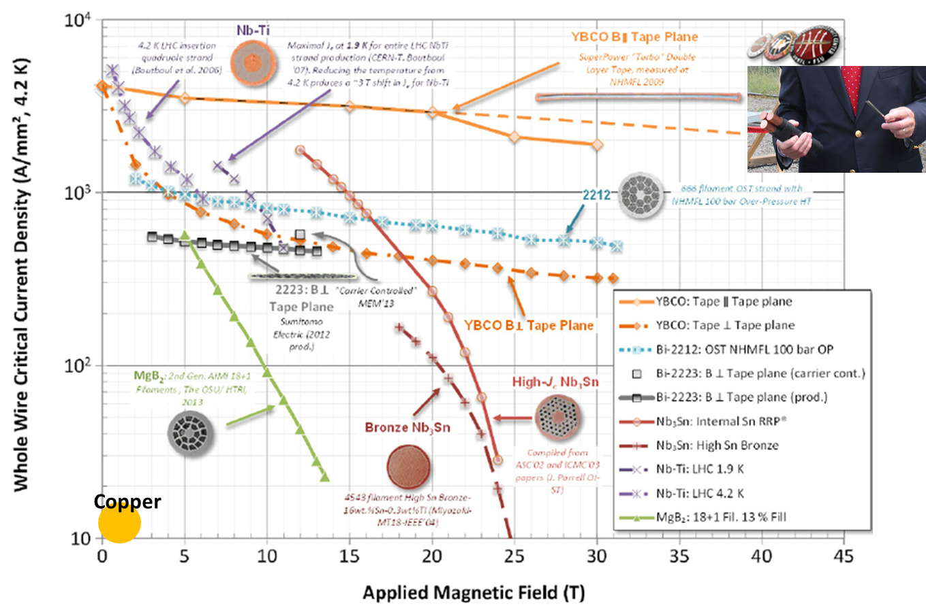
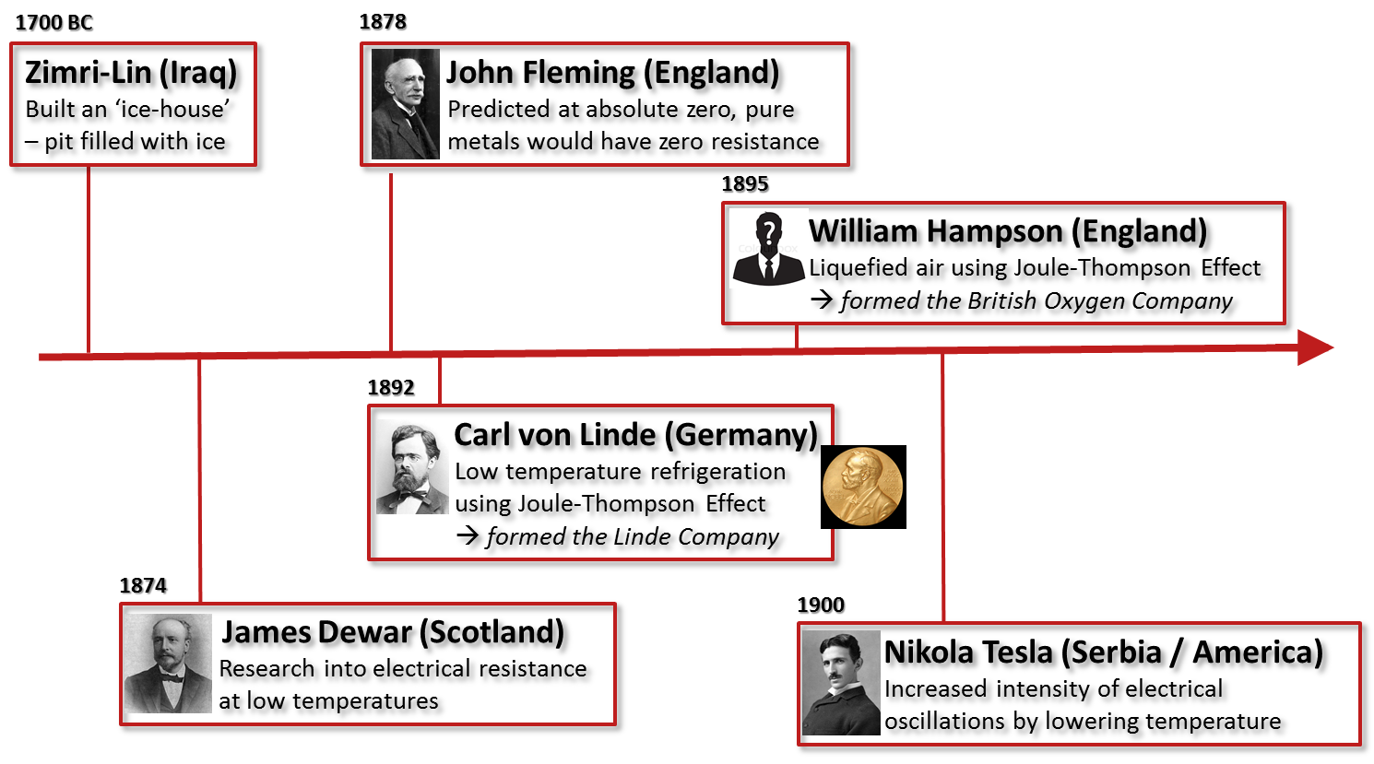
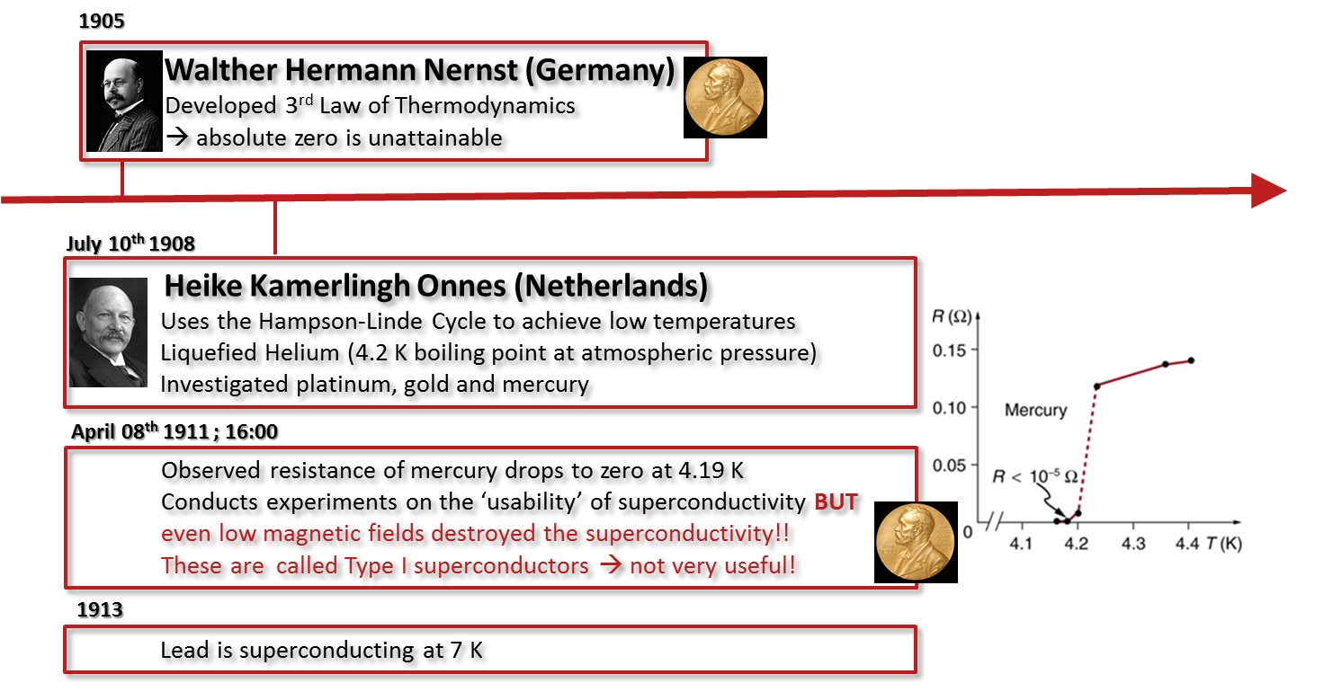
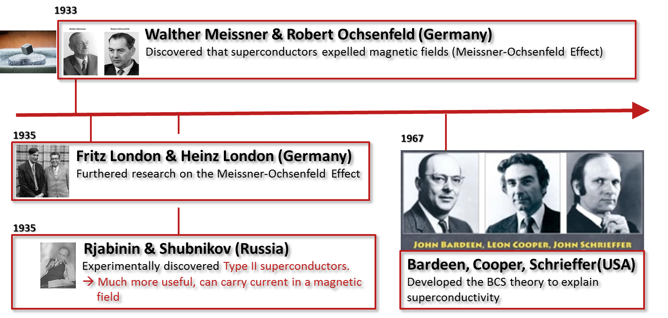
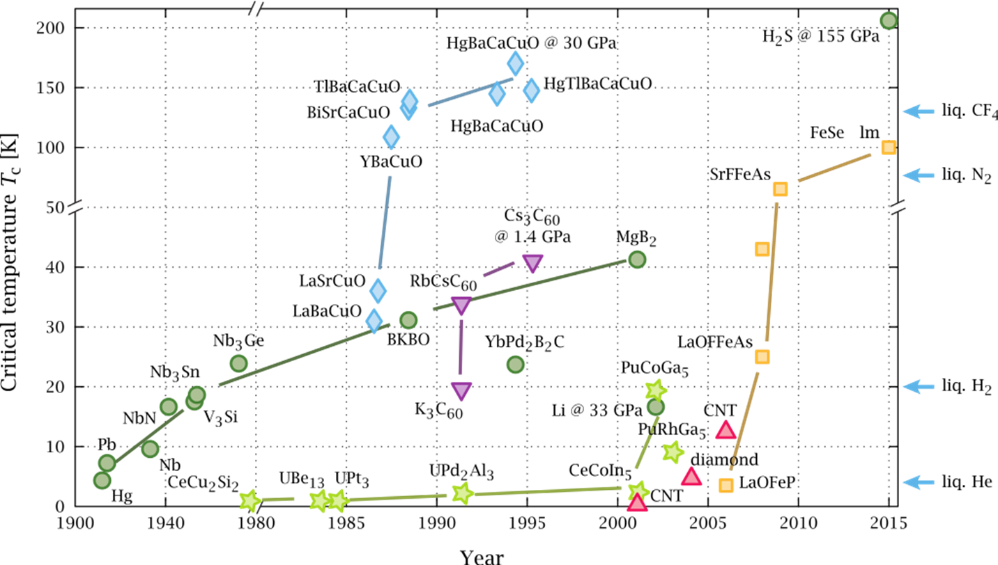
Superconductivity
Thomas Jefferson National Accelerator Facility
What is it?
How do we produce useful magnetic fields?
Superconductivity allows electricity to flow through a conductor without resistance.
If you flow electricity into a metal wire loop, it will conduct electrical current until the power source is removed.
BUT if the loop is made superconducting by keeping it cooled with liquid Helium, you could start a flow of electricity, remove the power source and ONE YEAR LATER the electricity WOULD STILL BE FLOWING!
Now that’s SUPERconductivity! It is a way of ELIMINATING energy loss!
By making loops of wire with lots of turns and flowing electrical current through the wire
Just like the coils we are using in our two big superconducting magnets, the TORUS and the SOLENOID
A coil of wire looks just like a magnet with North and South poles
Why do we use superconducting magnets?
So we can produce HIGHER magnetic fields, make our magnets SMALLER and INCREASE overall efficiency.
A small amount of superconductor can carry much more electricity than the same amount of Copper
The chart here shows some of the different types of superconductor and how much electrical current they can carry to produce different magnetic fields – can you spot where Copper is?
Here you see an ordinary cube-shaped magnet floating above a disc of superconducting material which is being cooled by liquid Nitrogen. This phenomena is called the Meissner Effect after one of the scientists who discovered it.
The superconducting disc behaves like a magnet and opposes the cube-shaped magnet forcing it to levitate.
History of Superconductivity
Superconducting materials and when they were discovered

